Slide 1
Notes:
Figure 1. Overall workflow

Slide 2
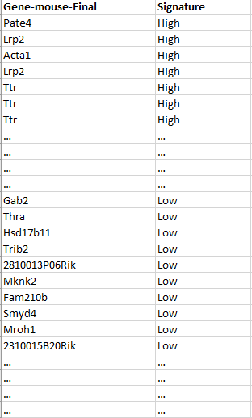
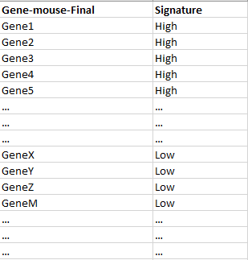
Eliminate target
genes
Re-calculate GATA2 activity
X₁
GATA2
PGR
Y₁
ξ₁
γ₂₁
γ₁₁
[SOX17]
Y₂
ξ₂
Notes:
Figure 2. Testing the biological hypothesis.

Slide 3
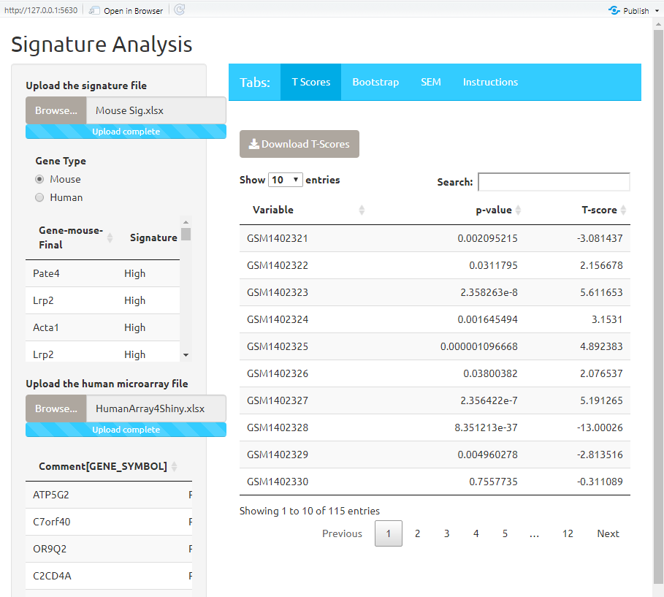
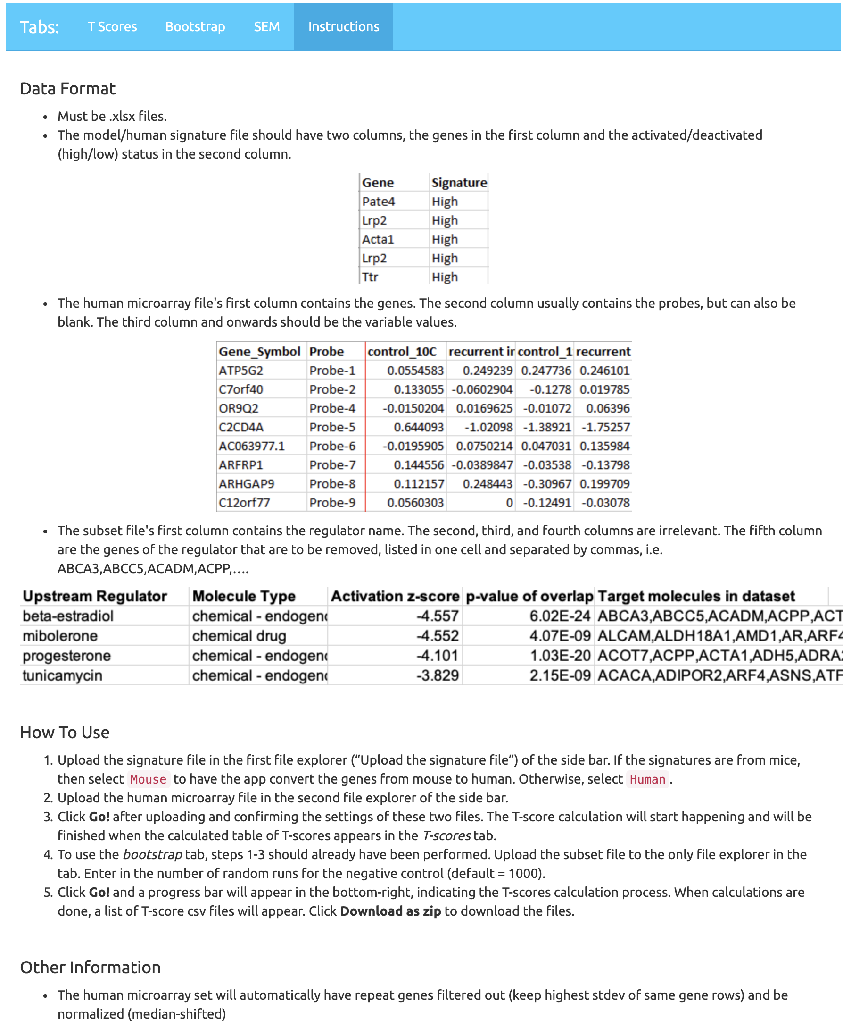


https://edelgene.niehs.nih.gov/ibsip2019/SignatureAnalysis/
Notes:
Figure 3. A screenshot of the Signature Analysis R Shiny application. It has four tab and the last tab shows the instruction of how to use this application. Two QR codes are for code repository on GitHub and a docker image.

Slide 4
GATA2 significant gene List
GATA2 significant gene List
All genes except GATA2&PGR (list)
+ SOX17
Random exclude N genes
A downstream target gene list (N)
Exclude downstream target genes
Shrunk significant gene List
Shrunk significant gene List
Add back to
the shrunk list
Random draw (N)
genes
Calculate the
activity with
the Signature
Analysis App
Restore back to the original number of genes
GATA2
PGR
GATA2
PGR
γ₁₁
γ₂₁
γ₁₁
ξ₁
γ₂₁
ξ₁
[SOX17]
[SOX17]
Calculate the activity with the Signature Analysis App
ξ₂
ξ₂
Notes:
Figure 4A A two-fold bootstrap strategies. On the left hand, we coin the name “elimination without replacement”; whereas the one on the right, “elimination with replacement”.

Slide 5
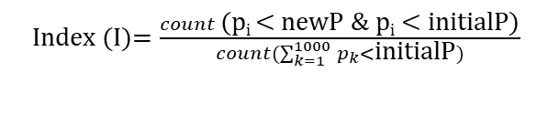
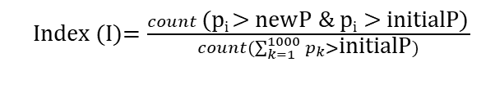
Shrunk significant gene List
Favorable impact
New p-val
of GATA2
Initial p-val
of GATA2
Adverse impact
If the new p-value is bigger
If the new p-value is smaller
For each holdoff p-value (p_{i})
Comparing the new pvalue
to the initial pvalue
For each holdoff p-value (p_{i})
Index (I)$=\frac{count \text{(}\text{pi}\text{ < }\text{newP}\text{ \& }\text{p}\text{i}\text{ < }\text{initialP}\text{)}}{count(\sum_{k=1}^{1000}{p_{k}<}\text{initialP})}$
Index (I)$=\frac{count \text{(}\text{pi}\text{ > }\text{newP}\text{ \& }\text{p}\text{i} \text{>} \text{initialP}\text{)}}{count(\sum_{k=1}^{1000}{p_{k}>}\text{initialP})}$
For the apparent constraint, the
index (I) would be a numerical value [0,1]
Notes:
Figure 4B. Based on the two-fold bootstrap strategies, an index value is calculated to infer the impact significance

Slide 6
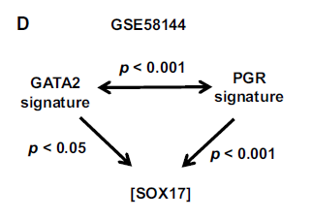
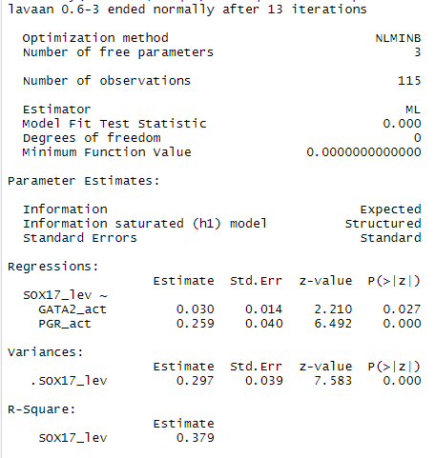
Notes:
Supplemental Figure 1. Validating the results from M-Plus with newly developed R-program

Slide 7
Regulator | Molecule Type | SEM p-value (GATA2) | SEM p-value (PGR) | p-value (IPA) | NumOfDownstreamGenes | Predicted Activation State (IPA)
ATF4 | transcription regulator | 0.0709 | 1.24E-11 | 0.000000252 | 34 | Inhibited
beta-estradiol | chemical - endogenous mammalian | 0.2264 | 2.02E-12 | 6.02E-24 | 289 | Inhibited
EGFR | kinase | 0.1184 | 6.02E-12 | 1.1E-10 | 73 | Inhibited
ERN1 | kinase | 0.0456 | 1.93E-11 | 1.58E-08 | 31 | Inhibited
FOXO3 | transcription regulator | 0.0513 | 1.40E-11 | 3.87E-10 | 62 | Activated
HOXA10 | transcription regulator | 0.0353 | 4.27E-11 | 2.74E-08 | 39 | Inhibited
MITF | transcription regulator | 0.0483 | 2.29E-11 | 5.91E-02 | 27 | Activated
progesterone | chemical - endogenous mammalian | 0.0927 | 4.72E-12 | 1.03E-20 | 124 | Inhibited
PTEN | phosphatase | 0.0741 | 1.78E-11 | 4.30E-08 | 83 | Activated
RUNX3 | transcription regulator | 0.0399 | 2.96E-11 | 3.10E-03 | 20 | Inhibited
TGFBR1 | kinase | 0.0327 | 5.00E-11 | 8.22E-03 | 14 | Activated
Vegf | group | 0.0699 | 6.57E-12 | 5.22E-06 | 72 | Inhibited
XBP1 | transcription regulator | 0.0276 | 5.68E-11 | 2.88E-09 | 45 | Inhibited

Slide 8
Upstream regulator | Molecular type | Index(I) | Impact | NumOfDownstreamGenes | IPA (p- value)
BCL6 | transcription regulator | <0.001 | Adverse | 28 | 9.96E-03
BRCA1 | transcription regulator | <0.001 | Adverse | 32 | 2.07E-05
CTNNB1 | transcription regulator | <0.001 | Adverse | 92 | 2.50E-04
EHMT2 | transcription regulator | <0.001 | Adverse | 9 | 7.90E-03
EP300 | transcription regulator | <0.001 | Adverse | 65 | 3.44E-06
MAX | transcription regulator | <0.001 | Adverse | 20 | 2.82E-05
NFYA | transcription regulator | <0.001 | Adverse | 15 | 3.68E-03
PML | transcription regulator | <0.001 | Adverse | 22 | 1.42E-03
SIN3A | transcription regulator | <0.001 | Adverse | 13 | 1.53E-03
SIN3B | transcription regulator | <0.001 | Adverse | 7 | 1.11E-03
SP1 | transcription regulator | <0.001 | Adverse | 80 | 1.66E-06
SP3 | transcription regulator | <0.001 | Adverse | 39 | 3.25E-06
TP73 | transcription regulator | <0.001 | Adverse | 47 | 8.98E-03
TWIST1 | transcription regulator | <0.001 | Adverse | 23 | 5.50E-03
YAP1 | transcription regulator | <0.001 | Adverse | 17 | 5.31E-03
ZNF282 | transcription regulator | <0.001 | Adverse | 3 | 2.16E-03
EZH2 | transcription regulator | 0.0023 | Adverse | 45 | 3.04E-03
TCF3 | transcription regulator | 0.0024 | Adverse | 41 | 7.42E-03
EGFR | kinase | <0.001 | Adverse | 73 | 1.10E-10
beta-estradiol | chemical - endogenous mammalian | 0.0019 | Adverse | 289 | 6.02E-24
PTEN | phosphatase | 0.0020 | Adverse | 83 | 4.30E-08
Vegf | group | 0.0022 | Adverse | 72 | 5.22E-06
MITF | transcription regulator | 0.0023 | Adverse | 27 | 5.91E-02
ATF4 | transcription regulator | 0.0024 | Adverse | 34 | 2.52E-07
progesterone | chemical - endogenous mammalian | 0.0038 | Adverse | 124 | 1.03E-20
ERN1 | kinase | 0.0263 | Adverse | 31 | 1.58E-08
RUNX3 | transcription regulator | 0.0470 | Adverse | 20 | 3.10E-03
FOXO3 | transcription regulator | 0.0531 | Adverse | 62 | 3.87E-10
HOXA10 | transcription regulator | 0.2416 | Adverse | 39 | 2.74E-08
TGFBR1 | kinase | 0.2808 | Adverse | 14 | 8.22E-03
XBP1 | transcription regulator | 0.9701 | Adverse | 45 | 2.88E-09

Slide 9
Summary
The Structural Equation Model (SEM) platform was successfully established in open source R language and applied in progesterone responsiveness network analysis
A web application developed with R shiny allows the automation on the Signature Analysis procedure, it also enables bench scientists to freely explore hypotheses
Two bootstrap procedures were designed to evaluate and assess the upstream regulator impact on the GATA2 function
An novel a non-parametric testing strategy was developed to evaluate the statistical significance metrics of the testing procedures
Extended the previous path analysis for establishing the important biological model for the transcriptional network
Successfully established the processes using lavaan R package and produced the same results as from M-Plus
Implemented a non-parametric testing strategy to evaluate the statistical significance metrics of the testing procedures
Demonstrated that the potential power and usability of the newly established SEM model in revealing the causal-responsive network

Slide 10
Summary
Demonstrated that the power and protentional usability of the newly established SEM model in revealing the causal-responsive network
An novel approach is introduced in the genetic research with a pilot study in human infertility model
Extended the previous path analysis for establishing the important biological model for the transcriptional network
Successfully established the processes using lavaan R package and produced the same results as from M-Plus
Implemented a non-parametric testing strategy to evaluate the statistical significance metrics of the testing procedures
Demonstrated that the potential power and usability of the newly established SEM model in revealing the causal-responsive network

Slide 11
SEM directory structure
SignatureAnalysis relates
Windows code: \\wine\Rshiny\apps
Internal app location: https://edelgene.niehs.nih.gov/ibsip2019/SignatureAnalysis/
https://edelgene.niehs.nih.gov/SignatureAnalysis/
How to access from linux server: /ddn/gs1/tools/shinyserver/apps/ibsip2019/
For SEM manuscript:
Online Linux access: /ddn/gs1/project/sem/
Window map: \\wine\SEM\Outlines\

Slide 12
Protocol to get bootstrap (with/without replacement)
Launch SA_application
Need to update the SA by adding two bootstrap choices
Get convention running
Load signature (human or mouse)
Load HumanMA (GSE58144)
Click “Go” to get Tscores
Go to BootstrapTab
Need a tab choice with/without
Upload the subset (UR results) file
Click “Go” to run

Slide 13
New bootstrap Application
Notes:
Square rooted for GATA2 pvalues
Negative log(10) PGR pvalues
Means of GATA2 p-values shifted to the right (a lot)

Slide 14
Notes:
Blue vertical line is new “GATA2 pvalue” after removing EGFR downstream genes, 0.1184
Upstream inhibitor (73 genes)

Slide 15
Notes:
Upstream activator (83 genes)

Slide 16
Notes:
Upstream activator: MITF (27 genes),
Perturb the system resulting in GATA2 because “insignificant” 0.0486

Slide 17
Notes:
Negative results,
XBP1 (45 genes) : upstream inhibitor

Slide 18
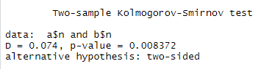
Model set up | GATA2-pvalue | PGR-pvalue
GATA2_act_FC13_P01&PRG_act_FC13_P01 | 0.02713765 | 8.43E-11
XBP1&PGR_act_FC13_P01 | 0.02762496 | 5.68E-11
Notes:
XBP1 (45 genes) : upstream inhibitor

